Slide 1


Slide 2
JUDGE EXPECTATIONS 2025
Professionalism
Communication
Social media stay off NO posts regarding judging

Slide 3
Check your Judge tools—cords, charger, power strip, headset, phone stand
Competition Suite—sign in, confirm captions before arriving at the show
Know HOW to use your phone, notifications, settings, focus-do not disturb, allow microphone, wifi, Bluetooth,
Notes:
Clean and Check mic in phone for dust. Cable connector—have a 2nd one available. Headset—check location of mic.

Slide 4
CBA Judge AFFILIATION Policy and Procedures
NOTE: It is the judge’s responsibility to declare and not adjudicate any contest where he or she has an affiliation.
Regional Judges: There will be a 10-day No Contact policy which will begin the Monday of Regional week and end the Friday following the last Regional for any regional judge.
A judge may consult and/or clinic competing bands and guards if the clinic takes place 10 days prior to judging this band.
A judge may clinic any one group no more than twice in a season.

Slide 5
Website: coloradomarching.org
Everything YOU need as a Judge:
JUDGING RESOURCES
NOT ON THIS PAGE:
CBA 2025 SALARY
DIGITAL TOTE
Percussion notes for Music Judges

Slide 6

Scoring Review

Slide 7
SCORING PRIORITIES
1.
RANKING
4.
RATING
SCORE
2.
SPREAD
3.
PROFILE

Slide 8
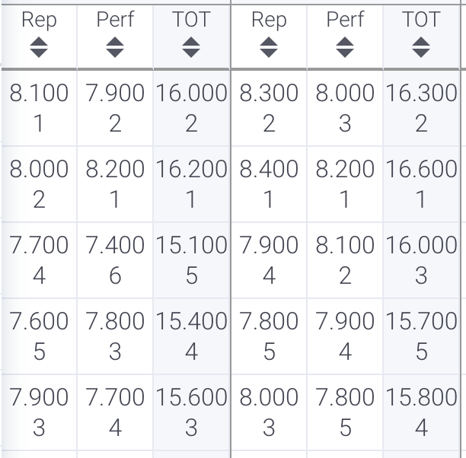
A TOTAL “SCORE” HAS 4 COMPONENTS
(in order of priority)
2. SPREAD: numeric distance between competitors
1. RANKING: sub-captions and overall
4. RATING: result of ranking, spreading, profiling and position on the criteria
3. PROFILE: relationship between
sub-captions for each team

Slide 9
SUB-CAPTION 1
TOTAL SCORE
1) ACCURATE OVERALL RANKING
2) NOT A TIE
SUB-CAPTION 2

Slide 10
Purposeful and not lazy
Let your rankings, spreads, and numbers tell the story of the contest
Adjusting
Notes:
.

Slide 11
SPREAD GUIDELINES
SPREAD =
the tenths that reflect the degree of difference between competitors
(NOT between
sub-captions)
INSIGNIFICANT (0-1 tenths)
MINOR (2-3 tenths)
NARROW (4-6 tenths)
SIGNIFICANT (7-9 tenths)
MULTIPLE SIGNIFICANT
(1 point or more)
DIFFERENCES
Notes:
Remind them of what insignificant, minor, narrow, significant, multiple significant mean in relation to bands in neighborhoods having different rankings with different performances. 1-9 tenths, teams can change ranking depending on the performance.

Slide 12
PROFILE = the relationship between the WHAT sub-caption and the HOW sub-caption for each team.
The WHAT is not “competing” with the HOW
The achievement of the RESPECTIVE CRITERIA may differ
Notes:
Do we mention derived achievement here?

Slide 13
The PROFILING GUIDELINES assist in this process.
PROFILING GUIDELINES | WHAT OVER HOW | HOW OVER WHAT
 | Up to approximately 1 point | Up to approximately 4 tenths
EXAMPLE: | 78/68 = 146 | 78/82 = 160
Notes:
guidelines are just that, maybe circle back to the question posed in the survey. 1,3,2 not an average….could easily be 1,7,2. It all depends on the neighborhood.

Slide 14
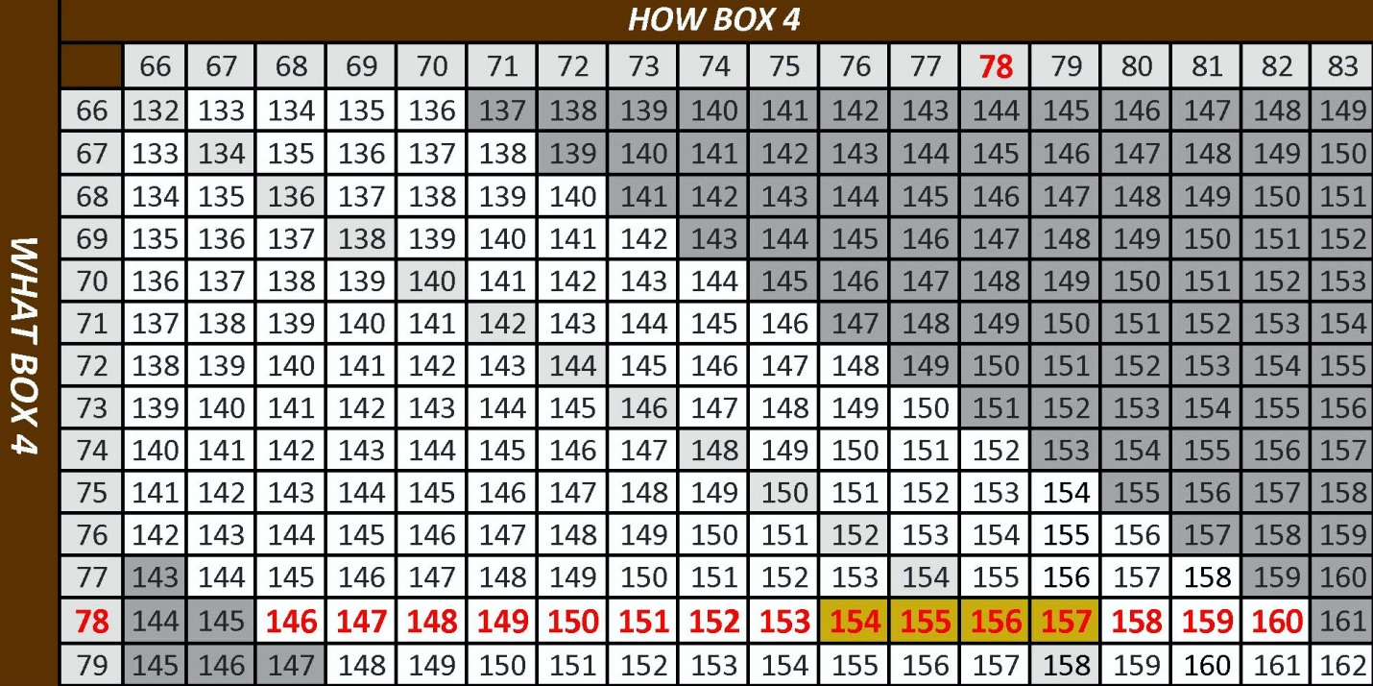
PROFILING RANGE
Using the full range of numbers available allows accurate
sub-caption ranking and spreading, without creating ties.
Without proper profiling, the score ultimately reflects only ONE sub-caption.
Notes:
Remind them - or ask for a volunteer - to describe using a full range of numbers.

Slide 15
ADJUSTMENT AND REFINEMENT
ADJUSTMENT & REFINEMENT allow the judge to continuously monitor, compare, and adjust scores as the contest progresses
Ties can / should be avoided
Spreads can reflect the actual difference between competitors
The process must be on-going throughout the contest, using both the spread and profiling guidelines
Judges should not try to adjust scores for competitors viewed hours earlier unless they are confident the adjustment is needed

Slide 16
SCORING PRIORITIES
1.
RANKING
4.
RATING
SCORE
2.
SPREAD
3.
PROFILE

Slide 17
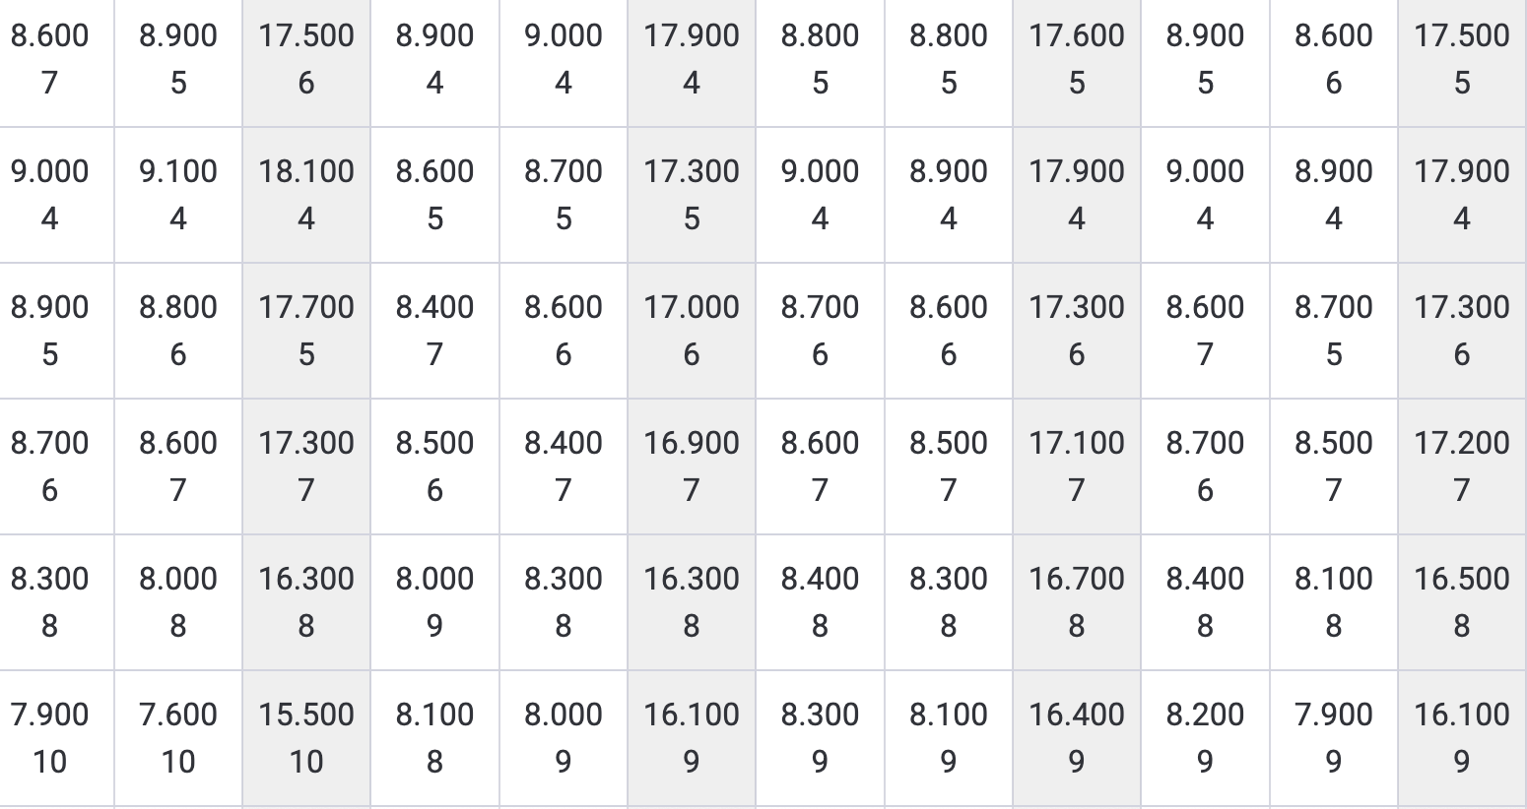
WHAT’S THE STORY?

Slide 18
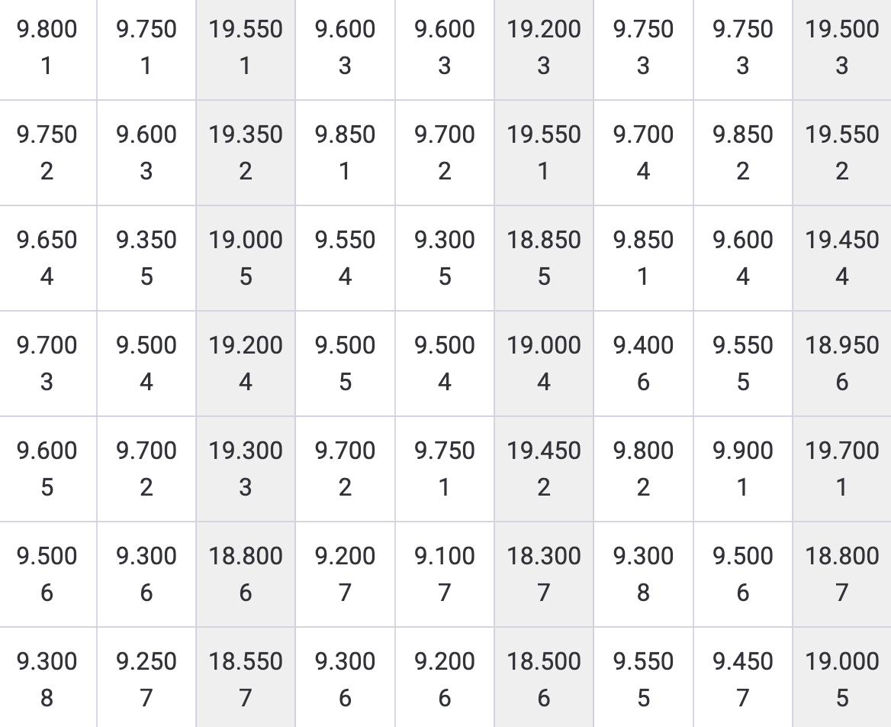
WHAT’S THE STORY?

Slide 19
HALF TENTHS
Safety net for you to ensure rankings are correct
Mostly applicable in larger contests.
Do not use in contests with 10 or fewer teams - refine and adjust
They are not meant to help “avoid” making clear decisions
Depending on the purpose of the contest, they have more applicability - prelims choosing finalists, for example
Let the system choose the winner while not diluting your caption

Slide 20
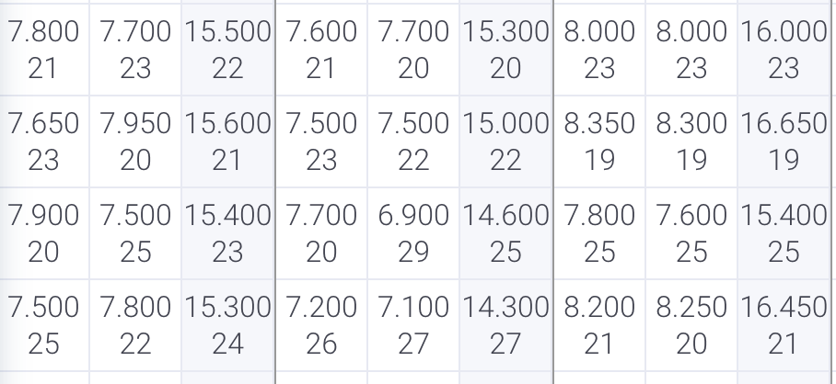
SOME CONSIDERATIONS - HALF TENTHS

Slide 21
Above all else,
THE PRIORITY IS TO HAVE THE RANKING CORRECT

Slide 22
REMEMBER THE PURPOSE OF YOUR CONTEST

